Slide 1

CONSTRAINS IN SQL

Slide 2
CONSTRAINTS
SQL constraints are used to specify rules for the data in a table . .
Constraints are used to limit the type of data that can go into a table . .
This ensures the accuracy and reliability of the data in the table . .
If there is any violation between the constraint and the data action, the action is aborted . .

Slide 3
Types of constraints in SQL
Domain constraints
Key constraints
Referential integrity
Domain constraints
Domain Constraints are user-defined columns that help the user to enter the value according to the data type.
And if it encounters a wrong input it gives the message to the user that the column is not fulfilled properly.

Slide 4
Types of domain constraints
1.Unique.
2.Not Null.
3.check .
4.Defult .
C_id | c_name | Age | Product
int | varchar(30) | int | varchar(30)
1 | Ram | 24 | Laptop
2 | Shyam | 25 | Laptop
3 | Krishna | 26 | Laptop
4 | Madhab | 27 | Laptop

Slide 5
Unique:- Unique record + one null value is allowed
syntax:- c_id int unique,
Not Null:- No null value allowed
Syntax:- S_name varchar(30) not null,
Check:- Check (Age>22 ) .
Syntax;- age int check (age>22),
Default:- In the product i want default product is Laptop
Syntax:- Product varchar(30) Default “Laptop”,

Slide 6
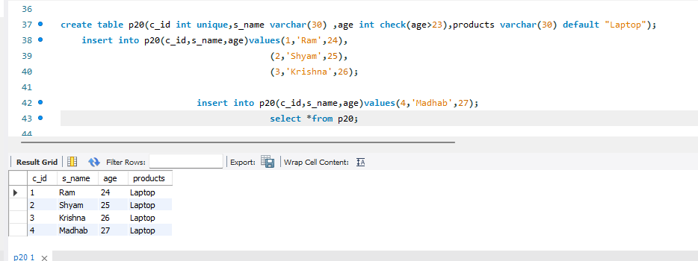

Slide 7
Key constraints .
A key constraint in a Database Management System (DBMS) refers to a set of rules applied to one or more columns in a database table to ensure the uniqueness and integrity of data.
Keys are used to uniquely identify rows in a table, and they play a fundamental role in establishing relationships between tables.

Slide 8
Referential integrity
Referential integrity is a term used in database design to describe the relationship between two tables. It is important because it ensures that all data in a database remains consistent and up to date. It helps to prevent incorrect records from being added, deleted, or modified.

Slide 9
THANK YOU
BY
AVINAB SINGH
avinabsinghkool@gmail.com

